Slide 1
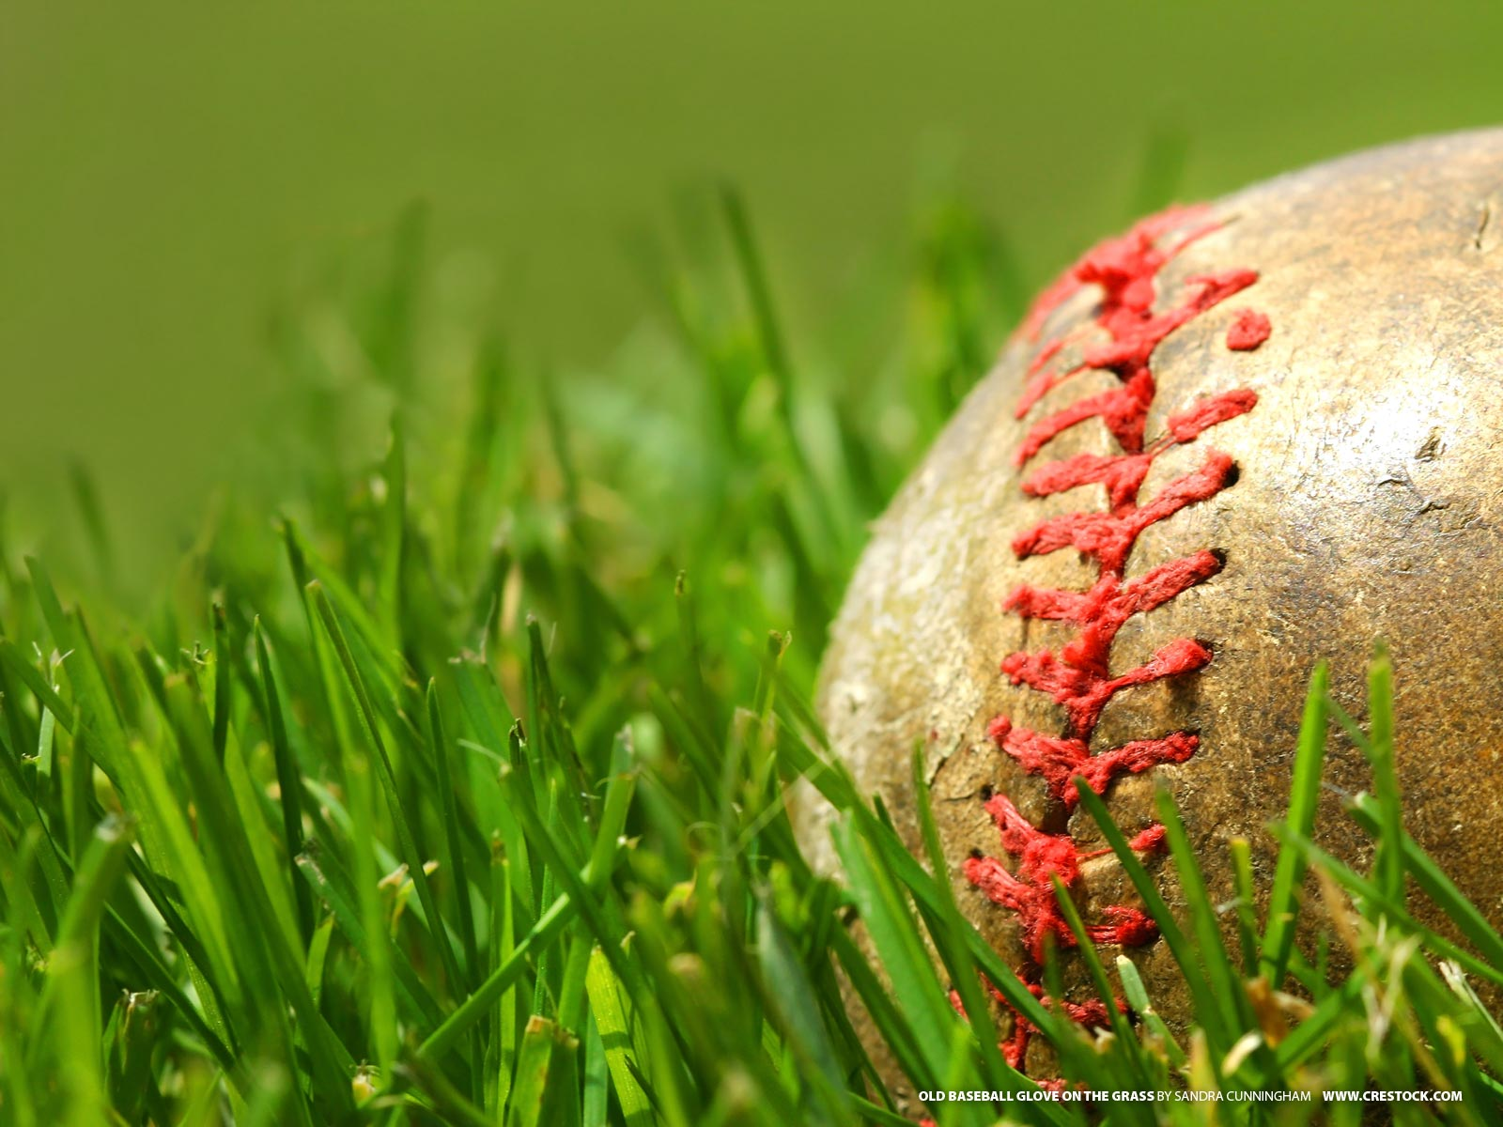
Designated Hitter == Offense?
Prepared for Major League Baseball
Ben Harwood
Rich Bump
Xavier Noel
Kevin Schaeffer
Delivered on 12/11/19

Slide 2
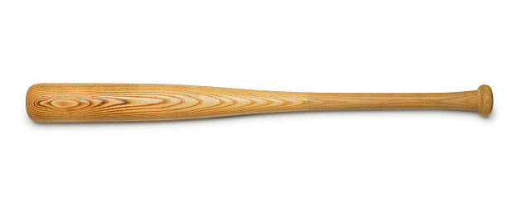

Introduction

Slide 3
Introduction
EDA

Slide 4
Introduction
Deeper Analysis
EDA

Slide 5
Introduction
Deeper Analysis
EDA
Conclusions

Slide 6
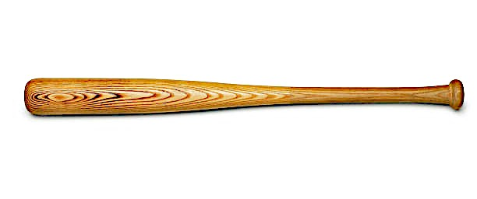
Motivation
Prepared for: Major League Baseball
Goal: Determine whether the NL adopting the DH will result in increased offense.
History
In 1973, the American League (AL) owners voted in rule 5.11 allowing one player (DH) to bat in place of the pitcher.
Pitching dominance in the late 1960’s drove the AL team owners to approve a 3-year trial of the DH.
The AL still uses the DH today, while the National League (NL) voted in 1980 to NOT adopt the DH rule.
Major League Baseball (MLB) has taken steps over the last decade attempting to increase interest amongst younger fans through increased offense.

Slide 7
Exploratory Data Analysis
Batting Data Summary
Statistics and Classification by Player, by Year
Data from 1871 through 2015
101,333 Rows
17 Different Statistics Kept, but only some kept for certain years.
Classifications for each player’s year by Team & League
Notes:
Need to add an author and script for the process around the EDA.

Slide 8
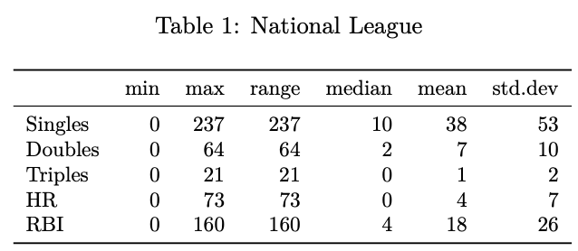
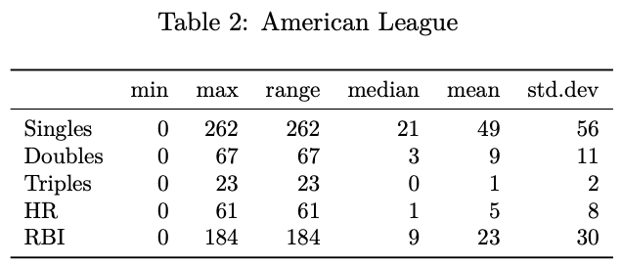
Exploratory Data Analysis
Notes:
Need to add an author and script for the process around the EDA.

Slide 9
First Research Question
Evaluate the trends and changes in the distribution of hit types over time by league.

Slide 10
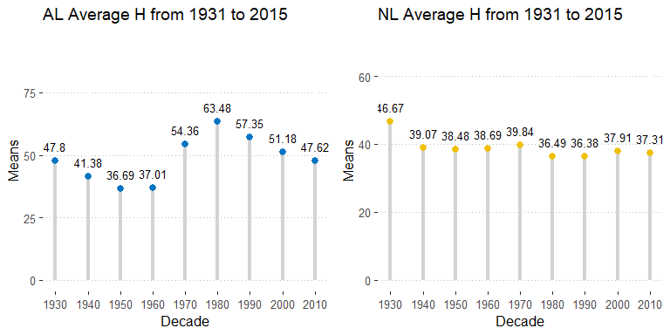
Exploratory Data Analysis
Notes:
Need to add an author and script for the process around the EDA.

Slide 11
Second Research Questions
Evaluate the changes in AL batting and runs after they adopted rule 5.11 and compare to NL.
Hits
RBI (Runs Batted In)
Batting Average

Slide 12
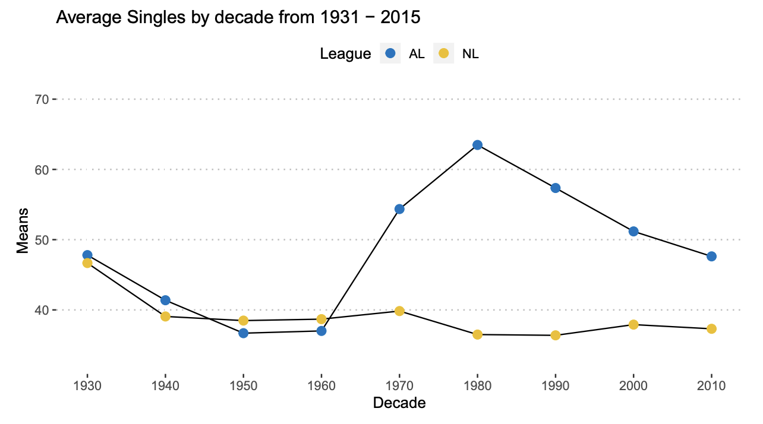
Exploratory Data Analysis
Notes:
Need to add an author and script for the process around the EDA.

Slide 13
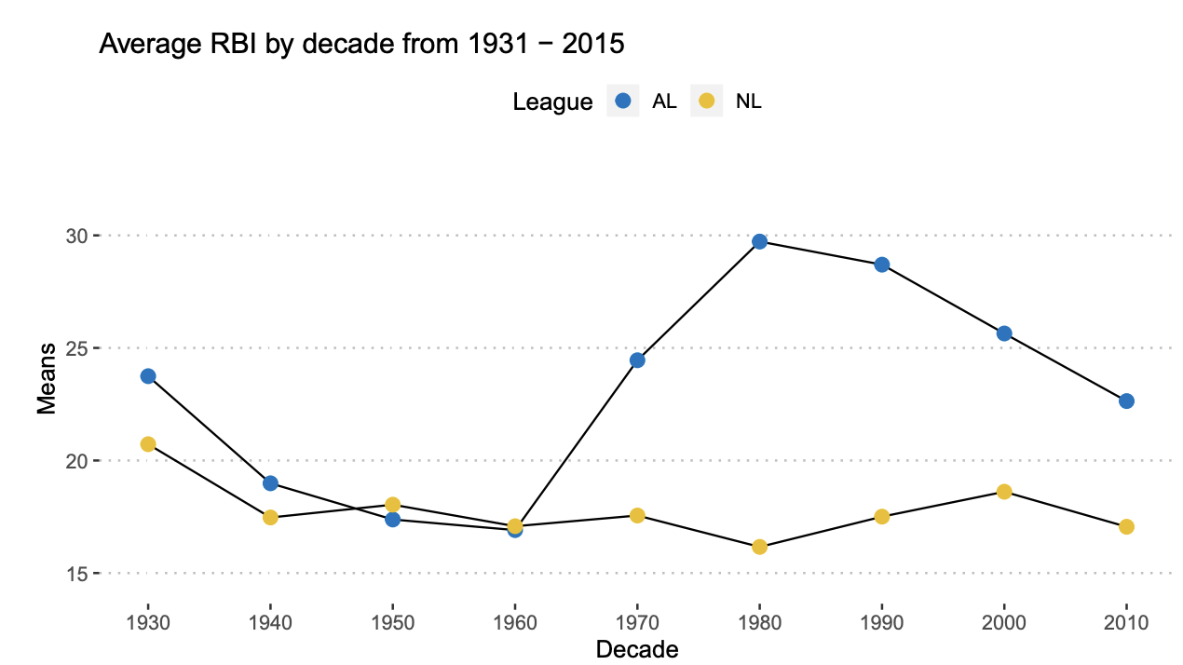
Exploratory Data Analysis
Notes:
Need to add an author and script for the process around the EDA.

Slide 14
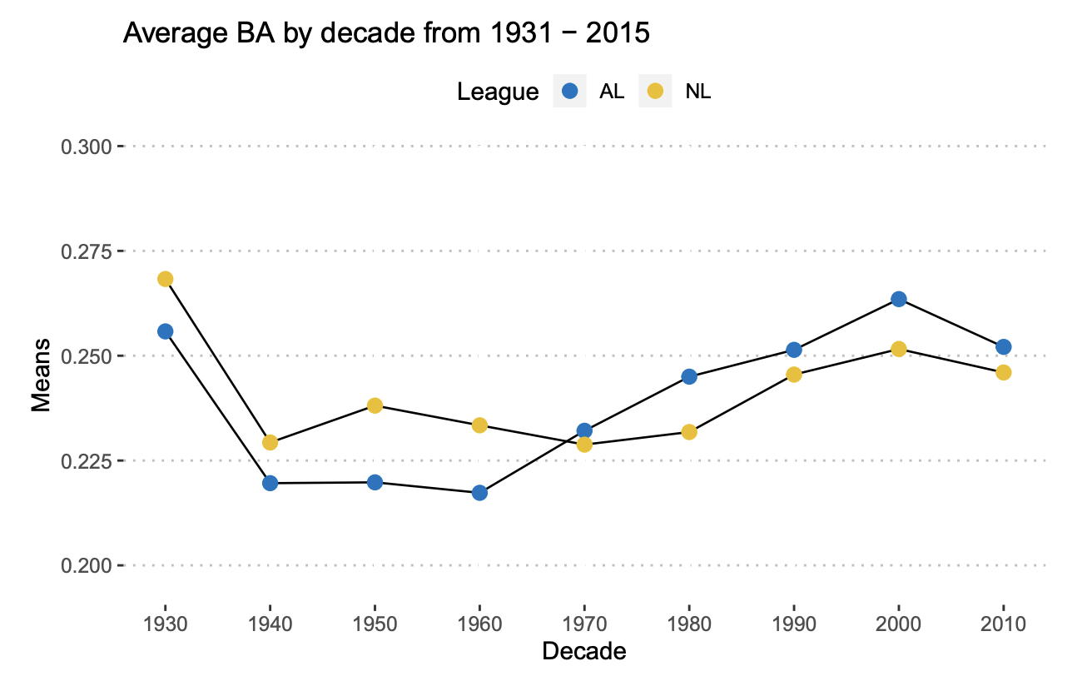
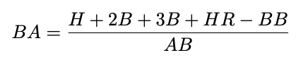
Exploratory Data Analysis – Batting Average
Notes:
Need to add an author and script for the process around the EDA.

Slide 15
Final Research Questions
Where do we go next?
Is there a relationship between hits and wins?

Slide 16
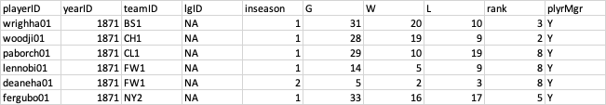
Exploratory Data Analysis - Wins
Managers Data Summary
Statistics and Classification by Manager (Coach), by Year
Data from 1871 through 2015
3,406 Rows
6 Different Statistics Kept
Classifications for each managers year by Team & League which we can use as an index.
Notes:
Need to add an author and script for the process around the EDA.

Slide 17
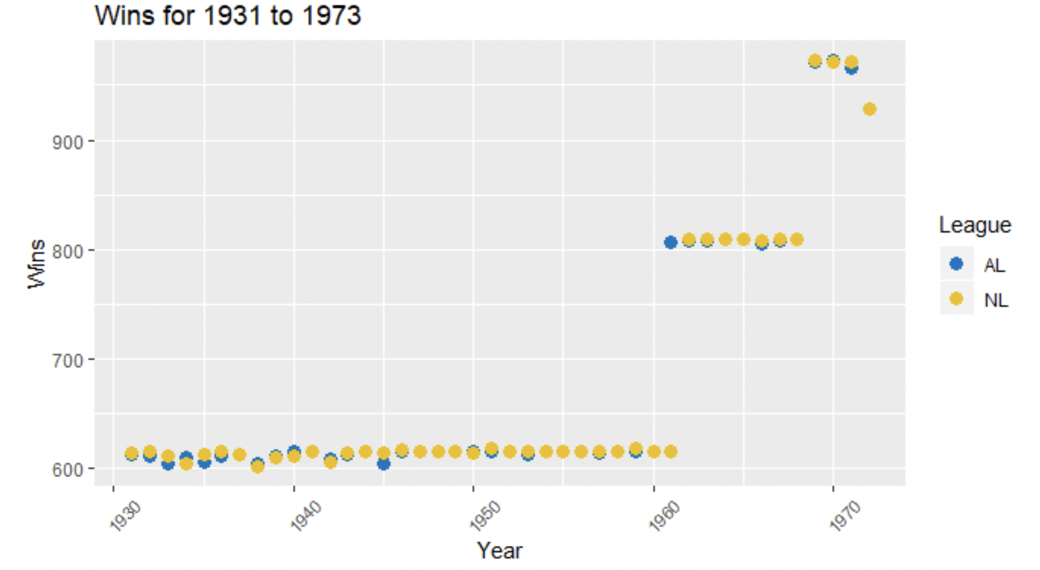
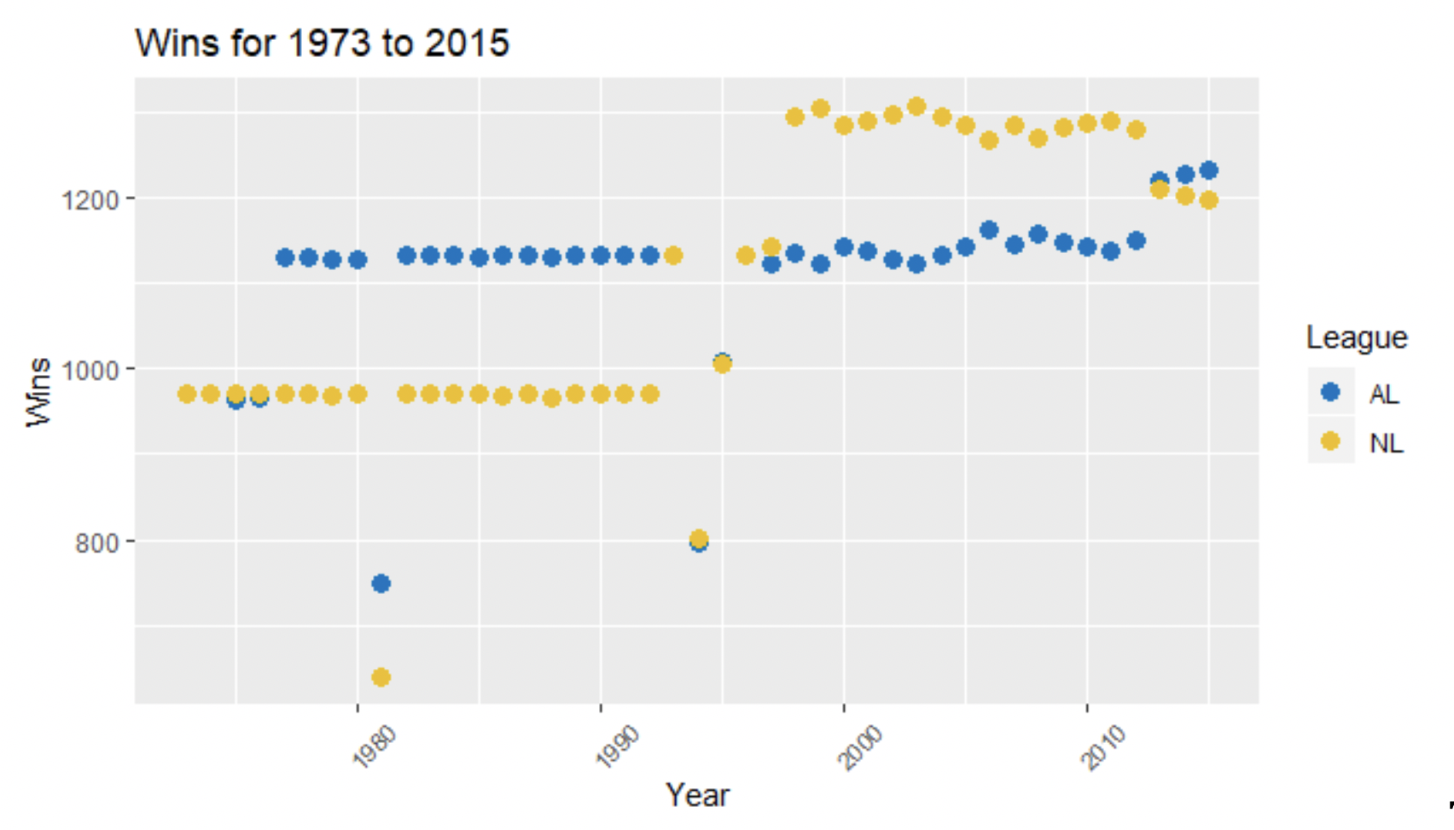
Deeper Analysis – Wins by League
Notes:
Need to add an author and script for the process around the EDA.

Slide 18
Final Research Questions
Where do we go next?
Is there a relationship between hits and wins?
Is there a relationship between hits and runs?

Slide 19
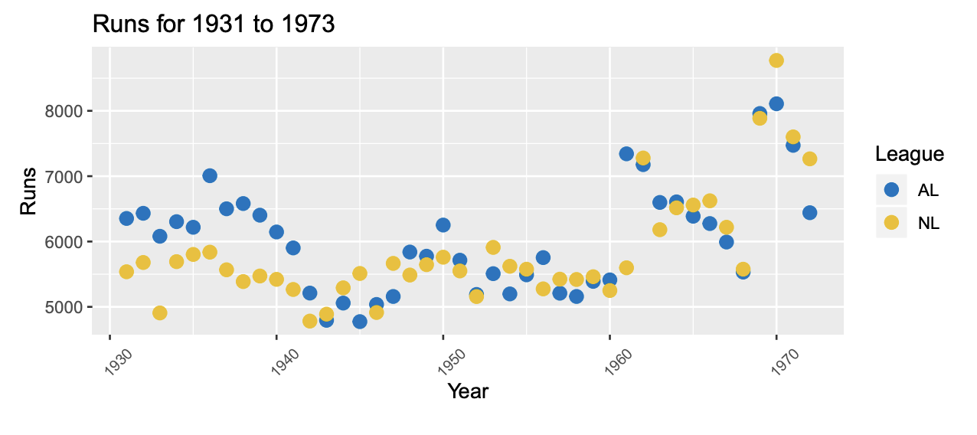
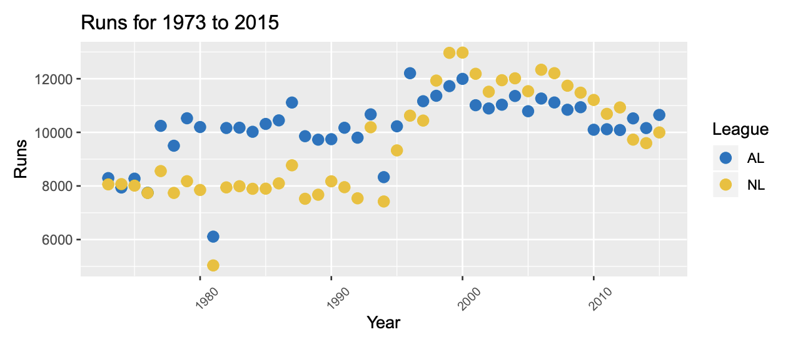
Deeper Analysis – Runs by League
Notes:
Need to add an author and script for the process around the EDA.

Slide 20
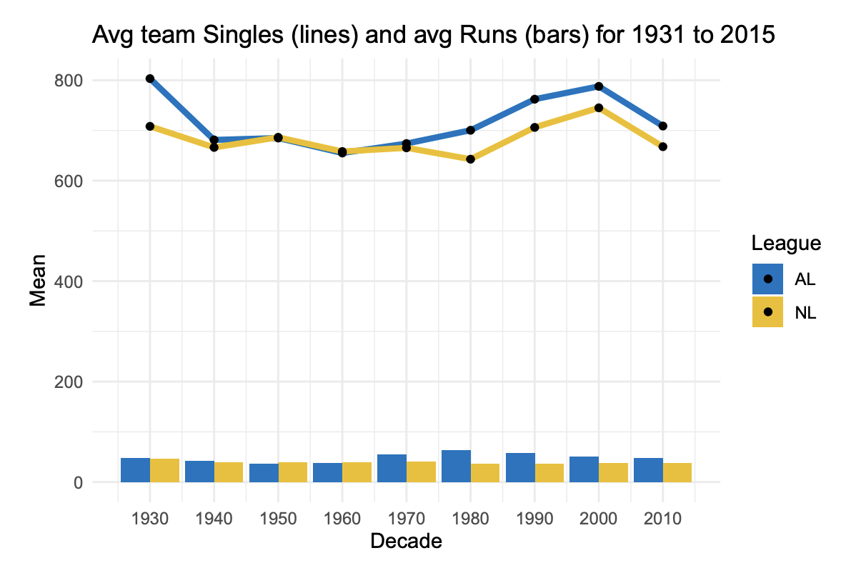
Deeper Analysis – Singles & Runs
Notes:
Need to add an author and script for the process around the EDA.

Slide 21
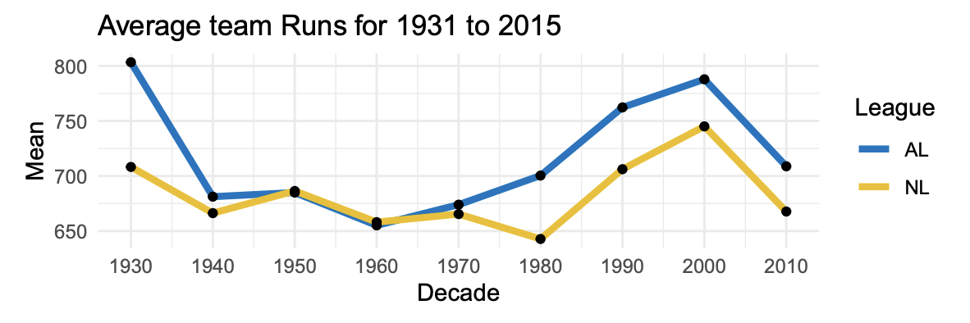
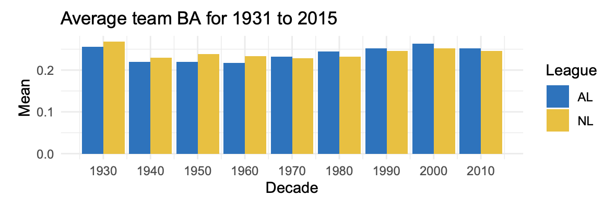
Deeper Analysis - Runs
Notes:
Need to add an author and script for the process around the EDA.

Slide 22
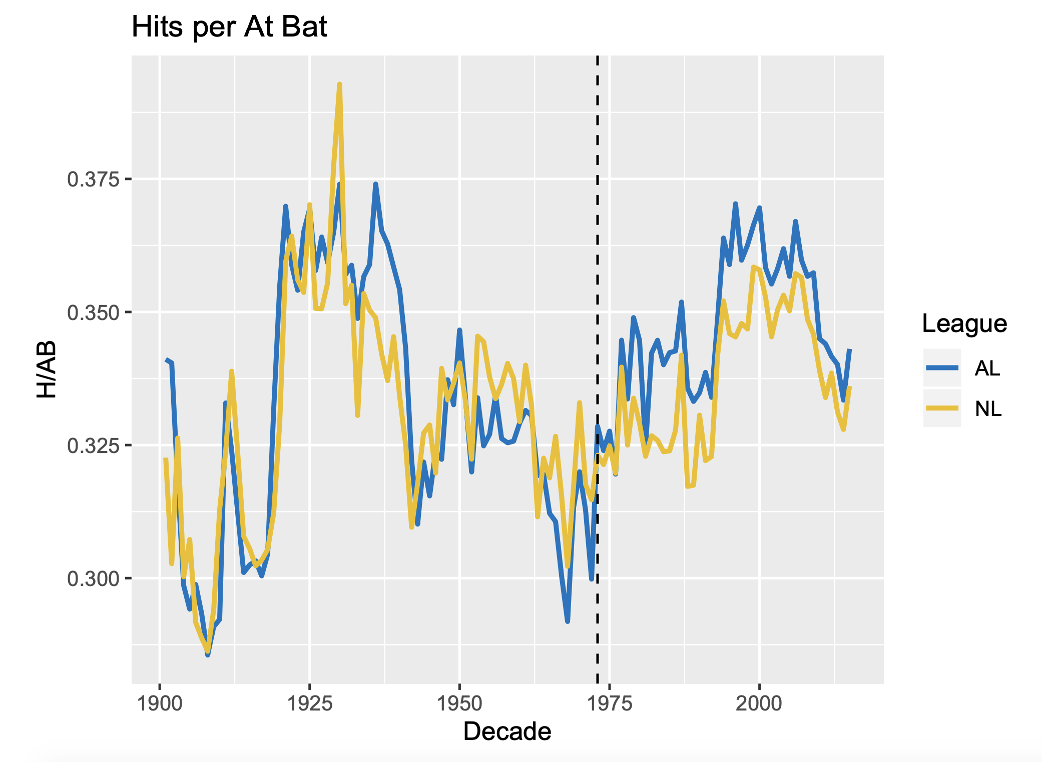
Data Modeling Analysis – T-Test
Single-Sample T-Test
Testing for AL hits/at bats being greater than NL hits/at bats
Created "hits per at bats”
The mean of the NL for that period is 0.33751
The mean of the AL for that period is 0.34787
The p-value of the single-tail, two sample t-test is 0.0002061

Slide 23
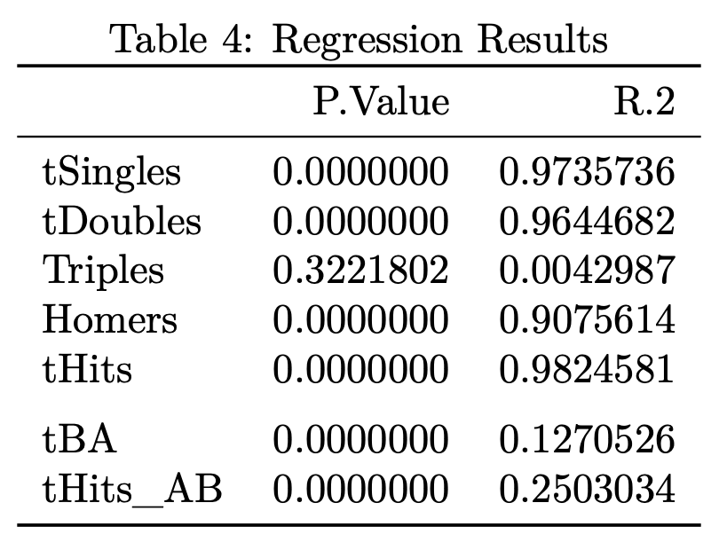
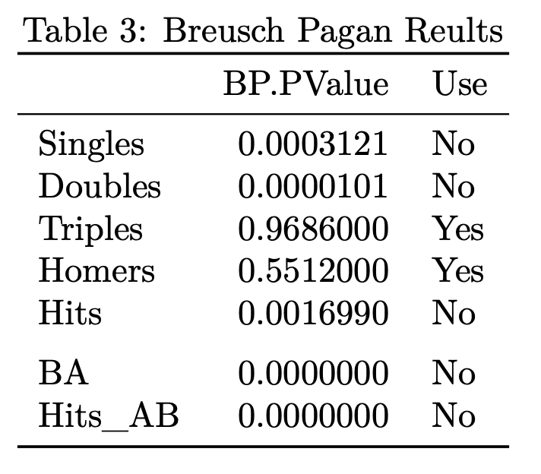
Data Modeling Analysis - Regression
Regression Testing
Relationship between different hit types & Runs
Relationship between Batting Average & Runs
Relationship between Hits per AB & Runs

Slide 24
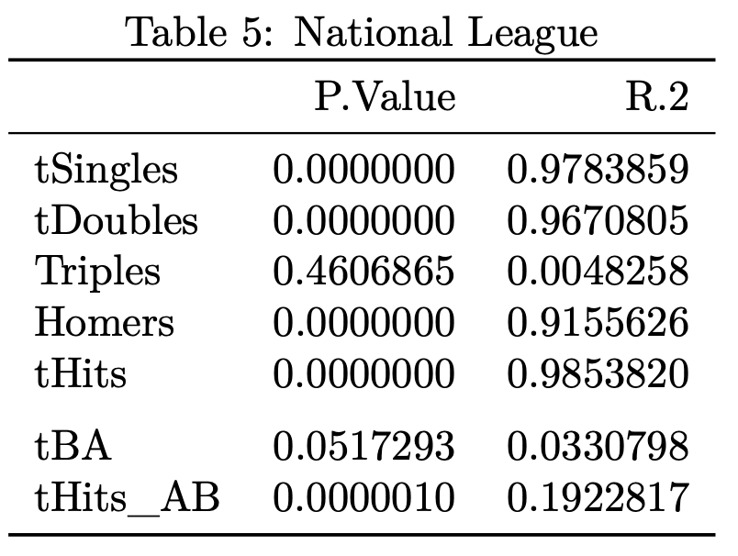
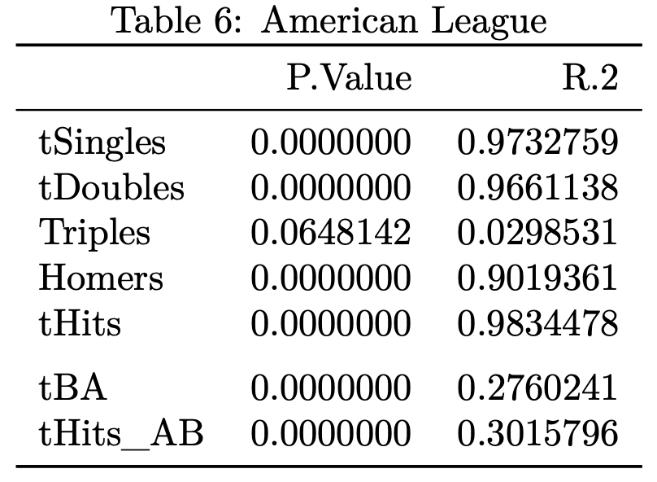
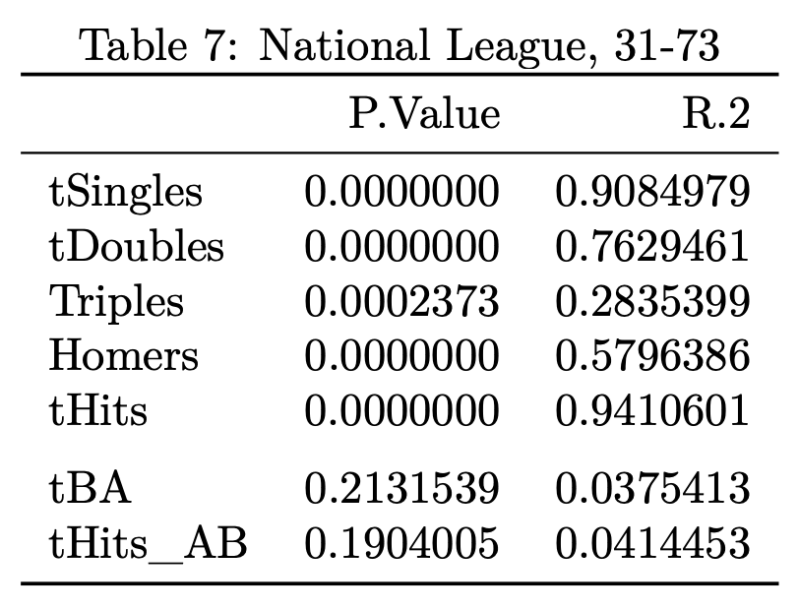
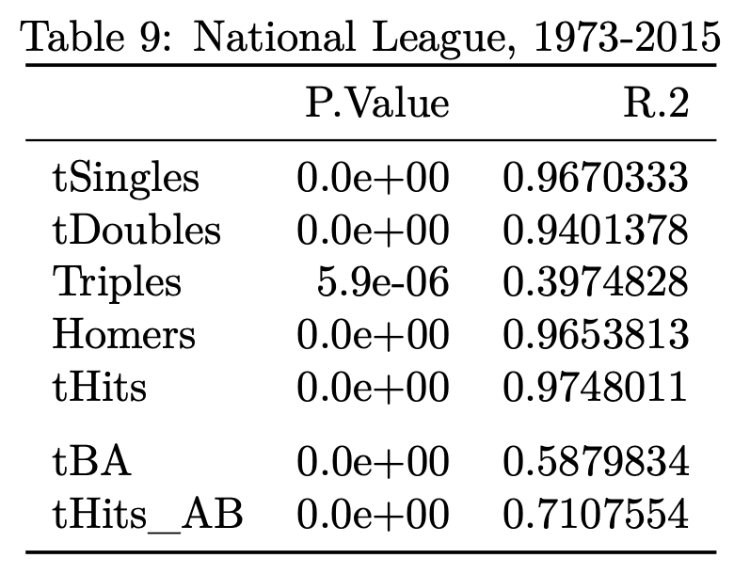
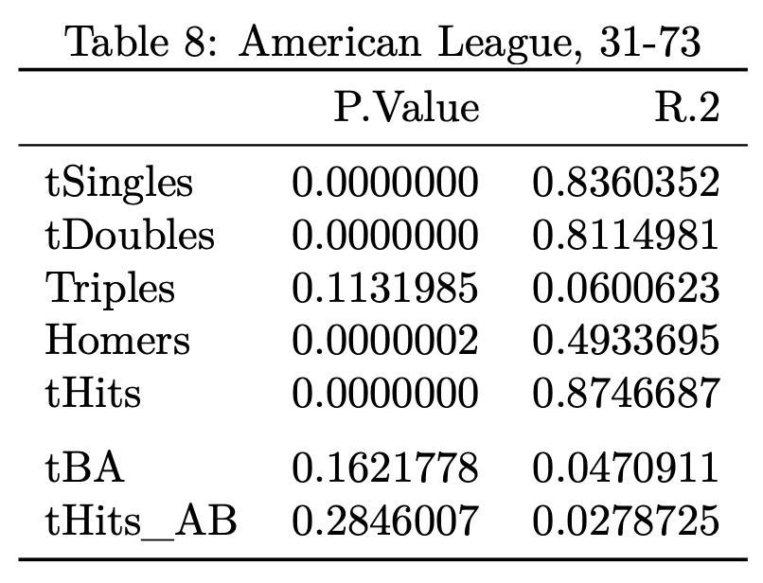
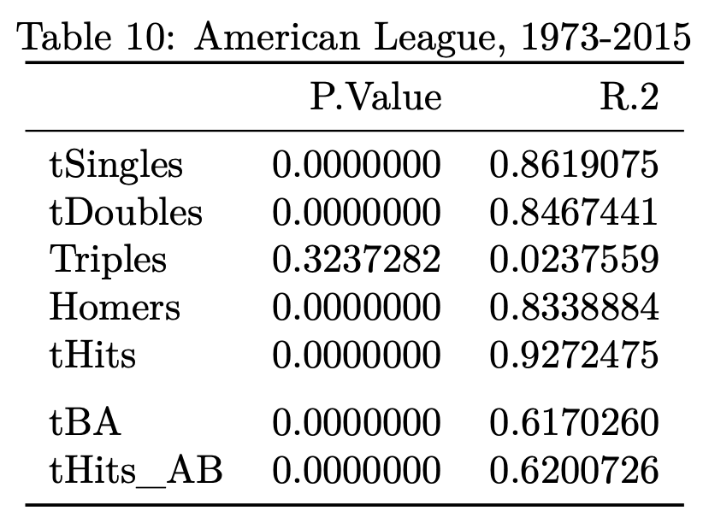
Data Modeling Analysis - Regression

Slide 25
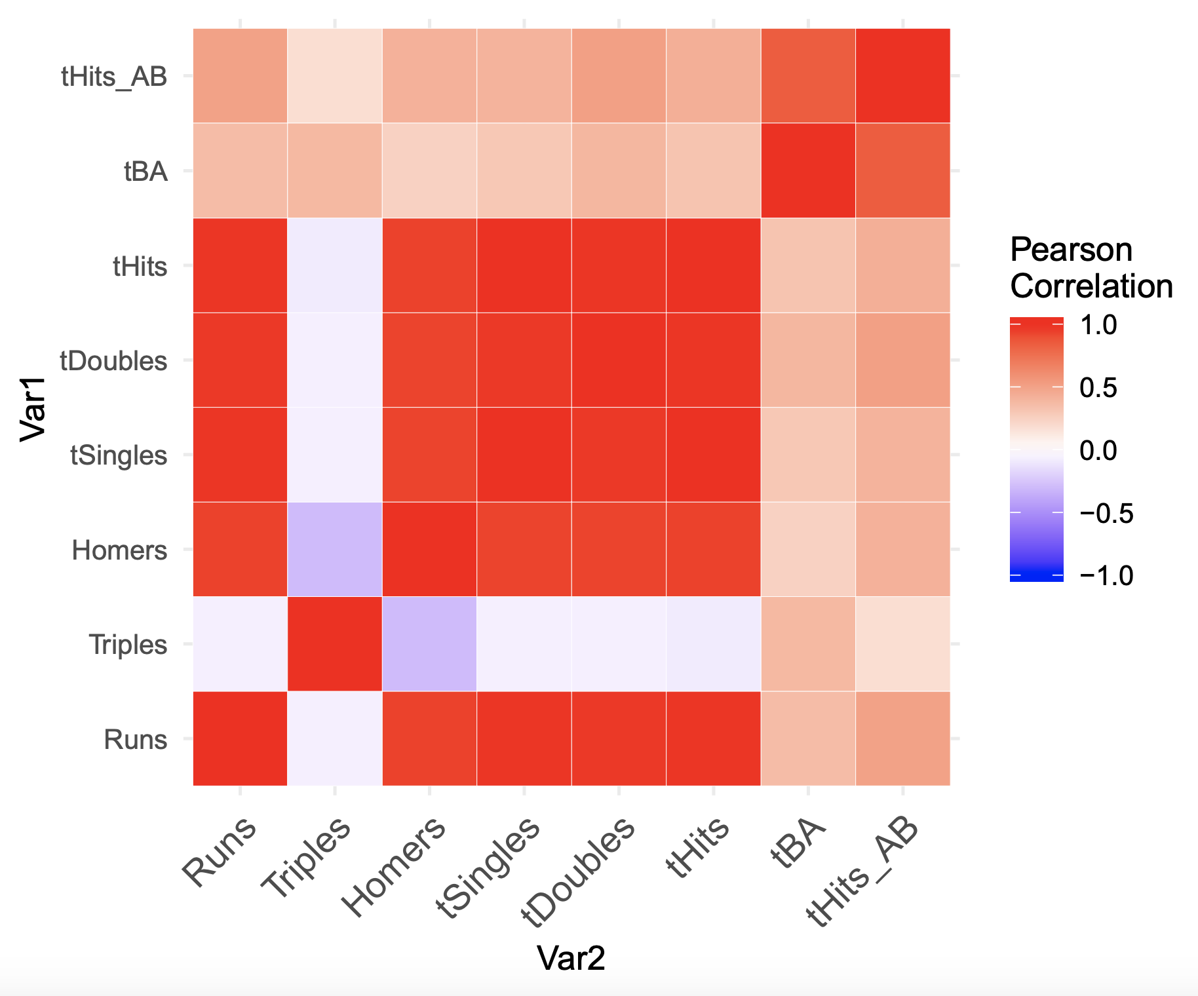
Data Modeling Analysis

Slide 26
Key Takeaways
The American League did see a spike in hitting after the the adoption of rule 5.11
Enough for us to dig further…
We did NOT have success correlating the batting statistics or changes to the number of wins.
HOWEVER
There is convincing evidence of a difference in the true mean of hits /at bat in the American league and National league with the designated hitter implemented, there is a 99.98% chance that there is an increase in offense generated by using the designated hitter.

Slide 27
Recommendations
The NL should make a change to adopt rule 5.11 as the AL did in 1973 if their goal is to increase offense.
Further analysis is required to explore the relationship between these offensive statistics with business value metrics like attendance or revenue.

Slide 28
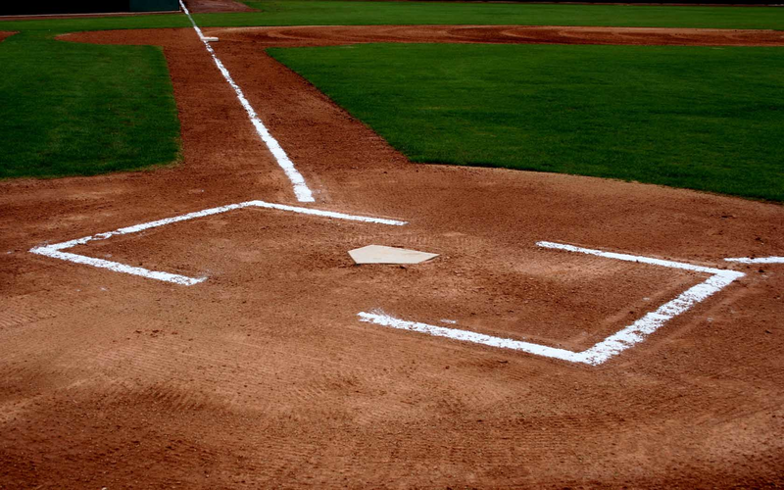
Thank You & Any Questions?

